Slide 1
OPI security APIs - demo -

Slide 2
APIs
Used in the demo:
rpc IPsecVersion (IPsecVersionReq) returns (IPsecVersionResp) {}
rpc IPsecStats (IPsecStatsReq) returns (IPsecStatsResp) {}
rpc IPsecLoadConn (IPsecLoadConnReq) returns (IPsecLoadConnResp) {}
rpc IPsecListConns (IPsecListConnsReq) returns (IPsecListConnsResp) {}
rpc IPsecListSas (IPsecListSasReq) returns (IPsecListSasResp) {}
rpc IPsecListCerts (IPsecListCertsReq) returns (IPsecListCertsResp) {}
Available but not used:
rpc IPsecInitiate (IPsecInitiateReq) returns (IPsecInitiateResp) {}
rpc IPsecTerminate (IPsecTerminateReq) returns (IPsecTerminateResp) {}
rpc IPsecRekey (IPsecRekeyReq) returns (IPsecRekeyResp) {}
rpc IPsecUnloadConn (IPsecUnloadConnReq) returns (IPsecUnloadConnResp) {}
https://github.com/opiproject/opi-api/tree/main/security

Slide 3
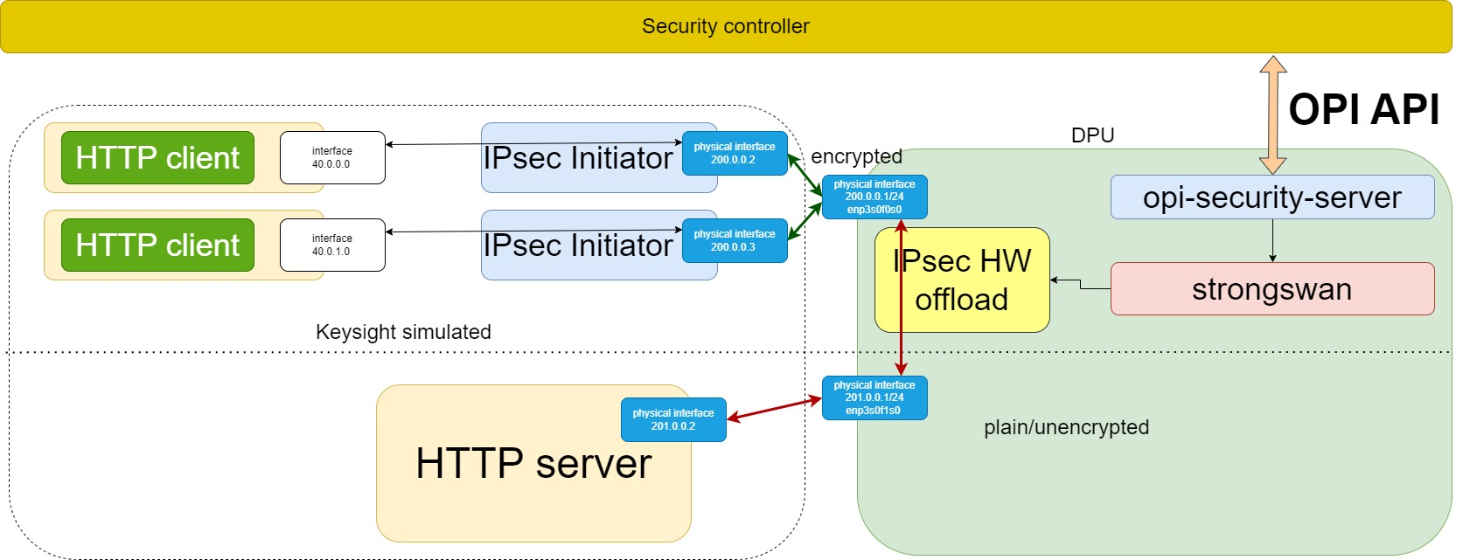
Demo topology

Slide 4
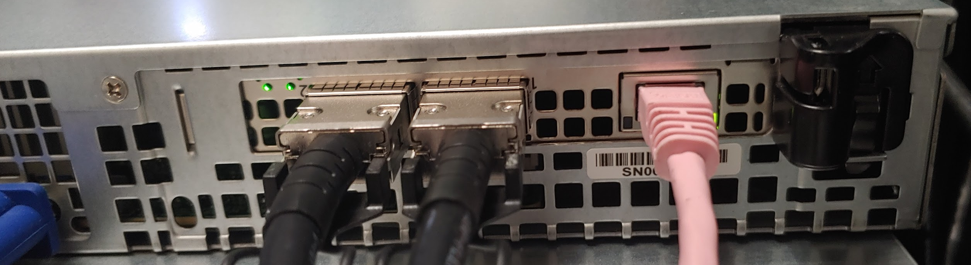
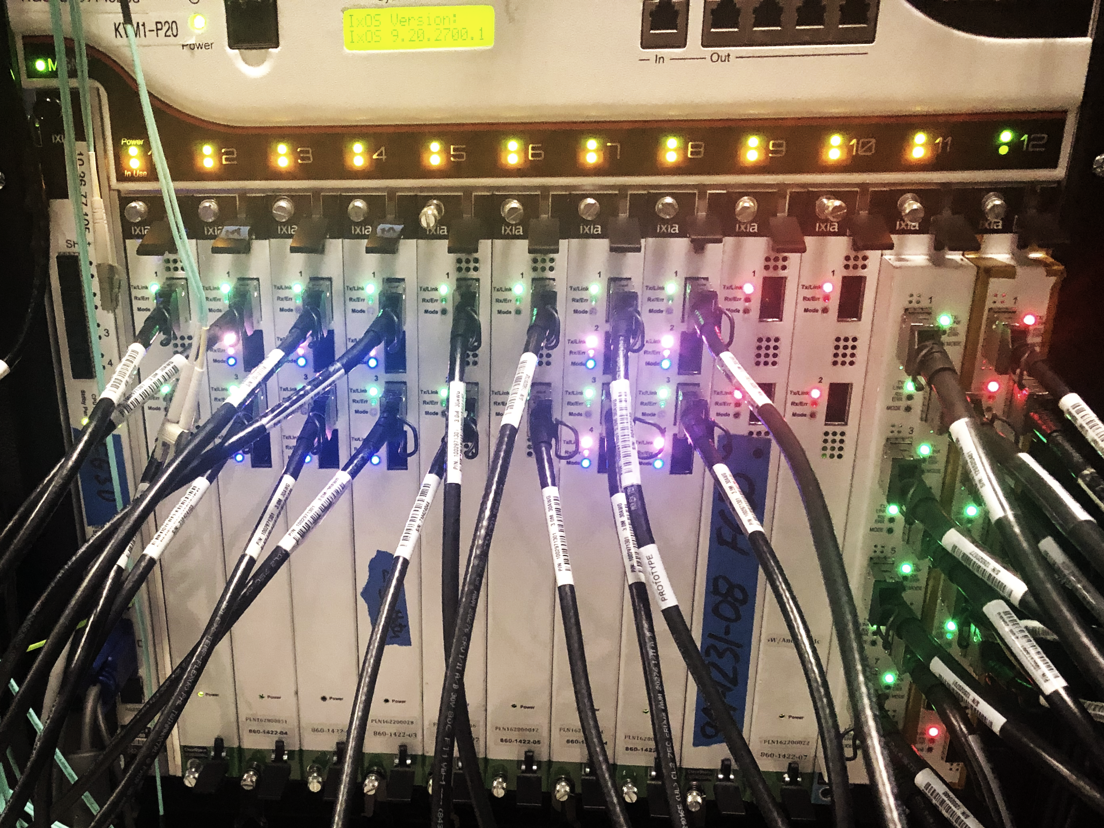
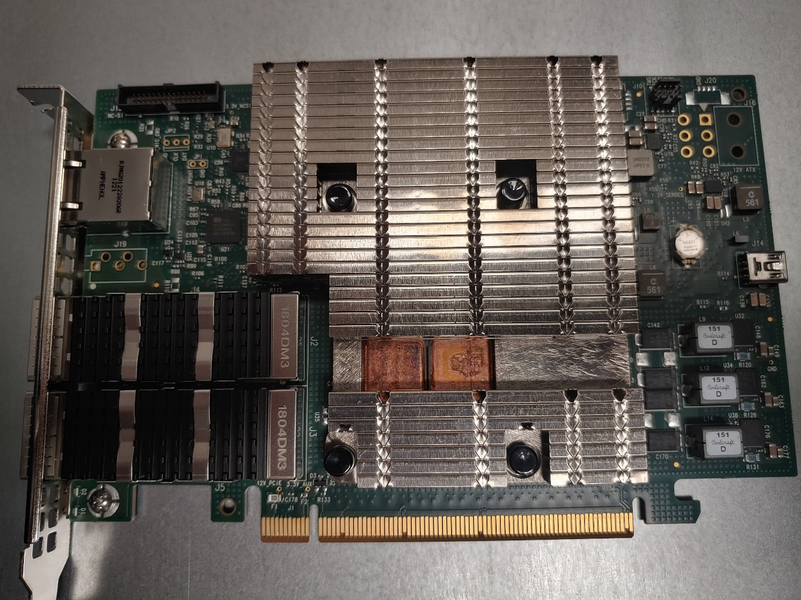
Testbed

Slide 5
DEMO

